Slide 1


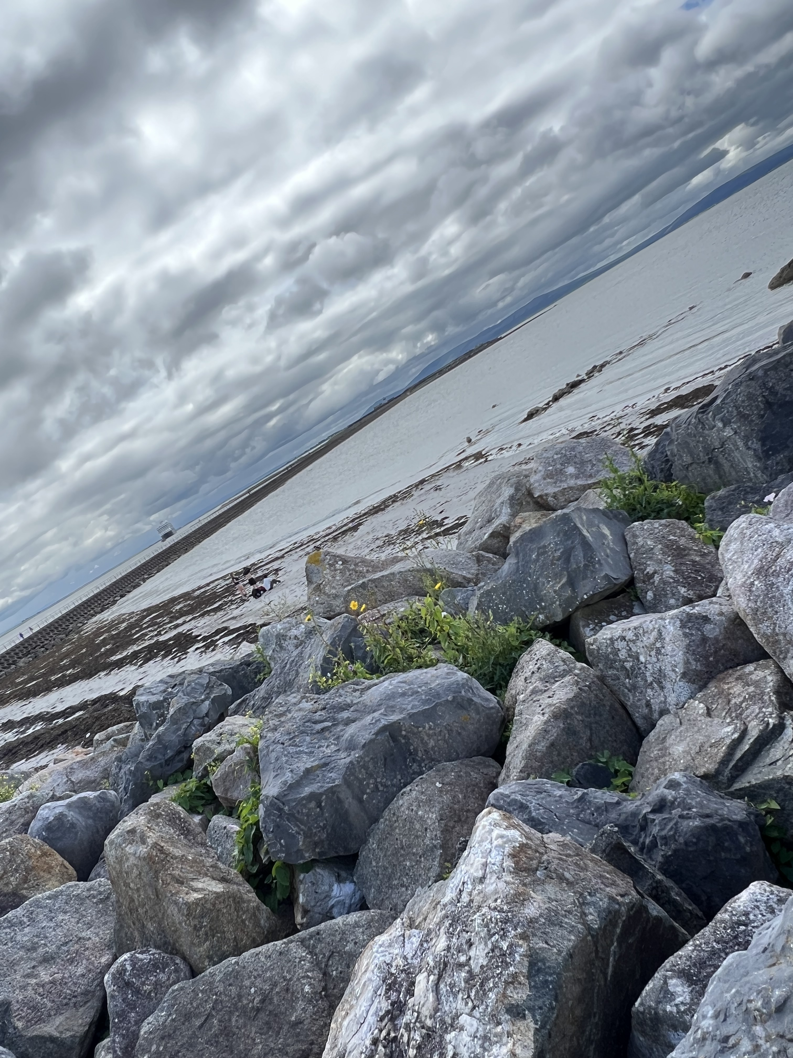

Turns out, there is more than one type of STEMMA user ….
Team 1, STEM(M)paths: Andrew Finnerty, Greg Kneidel, Ray Siemens, Xinyi Zhang

Slide 2

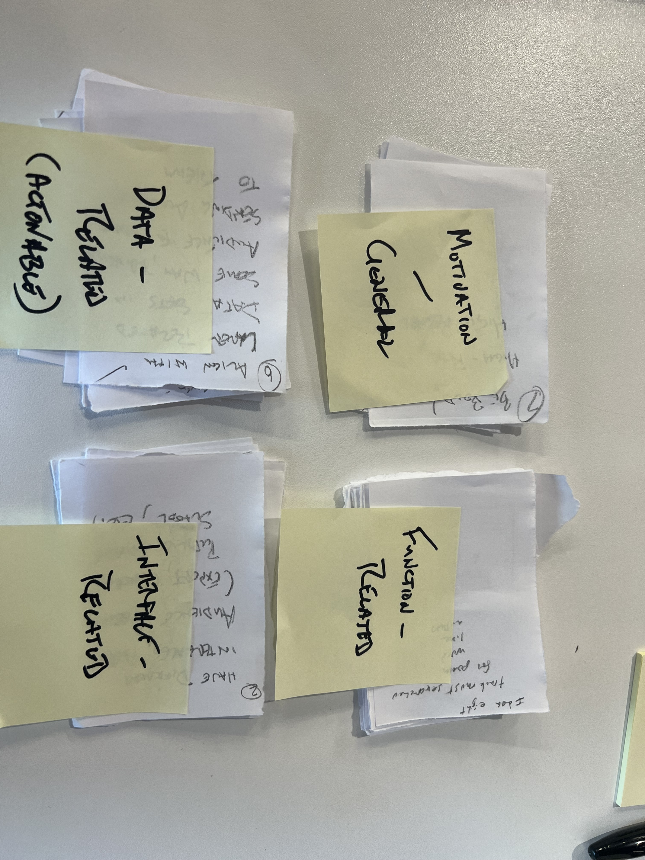
Approach
Empathy: Users wanted to be able to do more than the current STEMMA data set allowed, in 2 main groups:
to locate poetry to read, study, or teach (~= find a poem)
to use it as part of expert research processes (~= get some data)
Design: Supporting two diverse user audience types
Ideate: Requires a combination of augmenting underlying STEMMA data (automated, aligned) and providing interface access to these two audiences

Slide 3
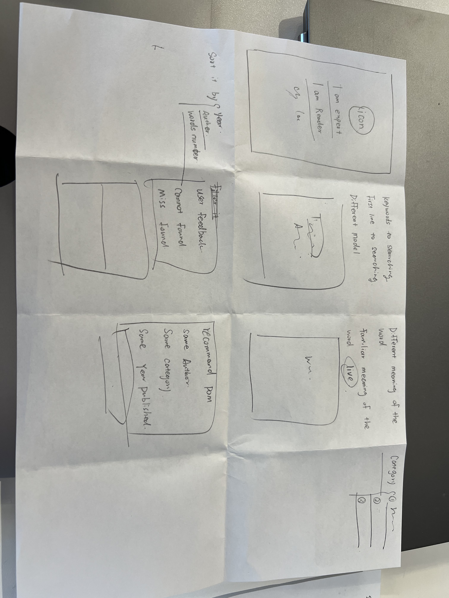

What We Found
Prototype: a simple splash page, separating use needs at first query, then providing tools and functions for each type of user
Interface GUI model
One function model: how to find the top hits in the STEMMA dataset (with apologies to the Riddle of Literary Quality project)
Test: How to support engagement? Alignment with professional groups and teaching-possibilities, as well as general reading public. Plus, we’d all like a ‘JD or TS’ quiz night ….

Slide 4
Contribution, Questions & Reflection
Contribution
Broaden audience, attracting reading public and students without alienating experts; encourage creative / cultural industry engagement
Build larger user community around STEMMA, aid in ongoing sustainability
Limitations, Open Questions
Data enrichment and munging could continue to prove challenging
Building community is challenging
Further exploration
The thought experiment got us this far, but we took it a few steps further … [1] a GUI Mockup and [2] the ‘Hot Tips on the Top Hits’ function

Slide 5
More tangible results [1] GUI MockUp

Slide 6
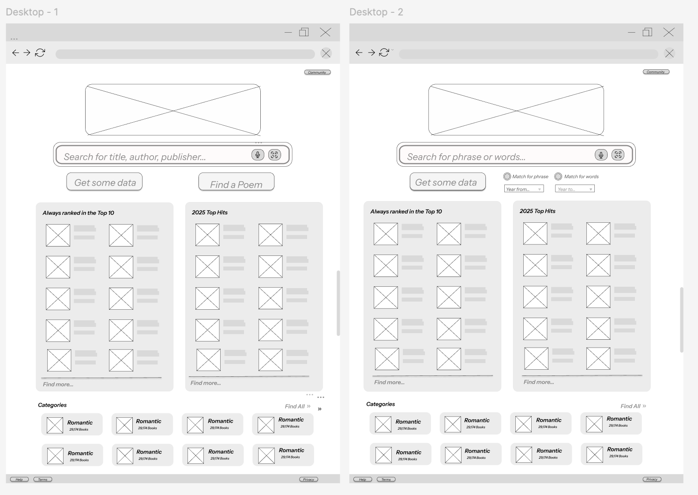

Slide 7
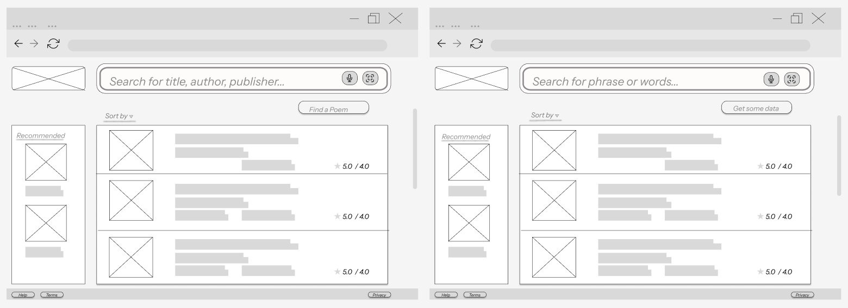

Slide 8
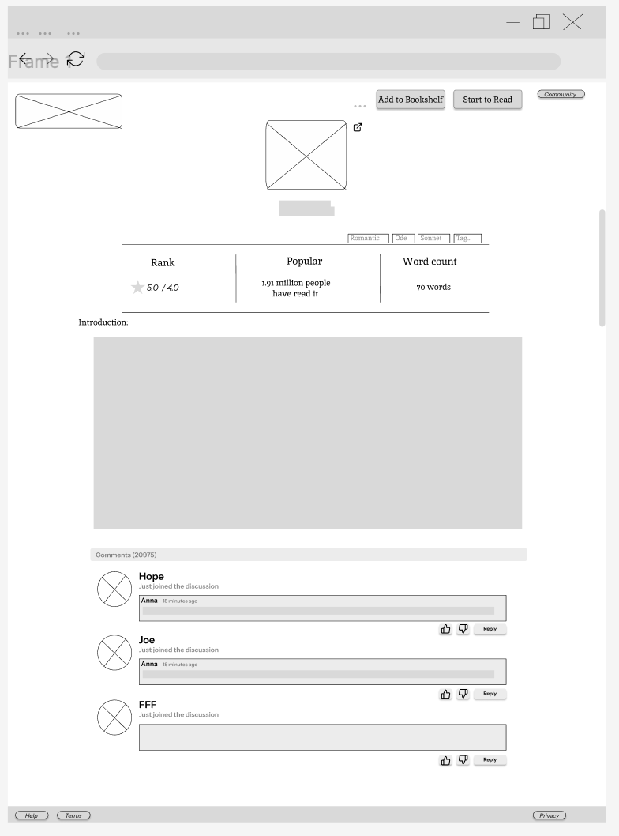
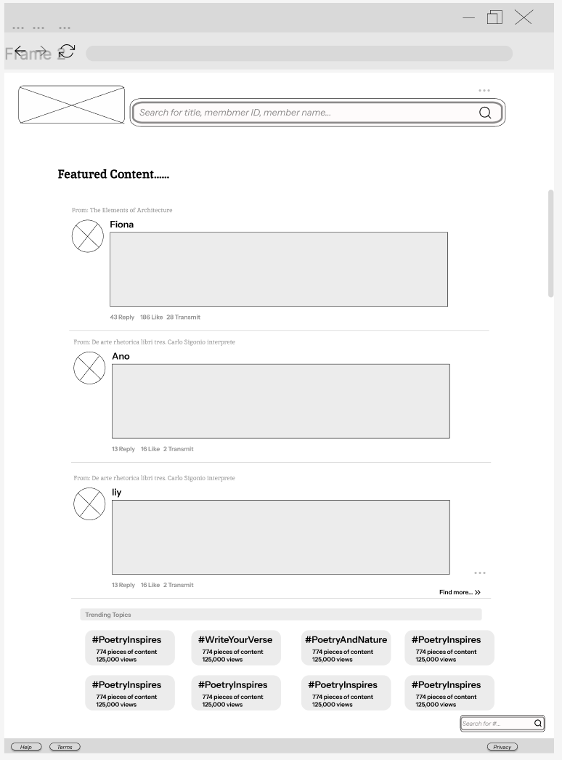

Slide 9
More tangible results [2] Hot Tips on the Top Hits
(Tracing Poetic Popularity in Manuscripts)

Slide 10

Research Question
How can we identify which poems were most popular in manuscript culture?
Archival data is fragmented and inconsistently structured.
Popularity may be tied to frequency, longevity, and spread.

Slide 11
Initial Approaches (What Didn't Work)
Lemmatising first lines to group poem variants
Semantic similarity (e.g., cosine distance in vector space)
Issues: textual variation, ambiguity, sparse features

Slide 12
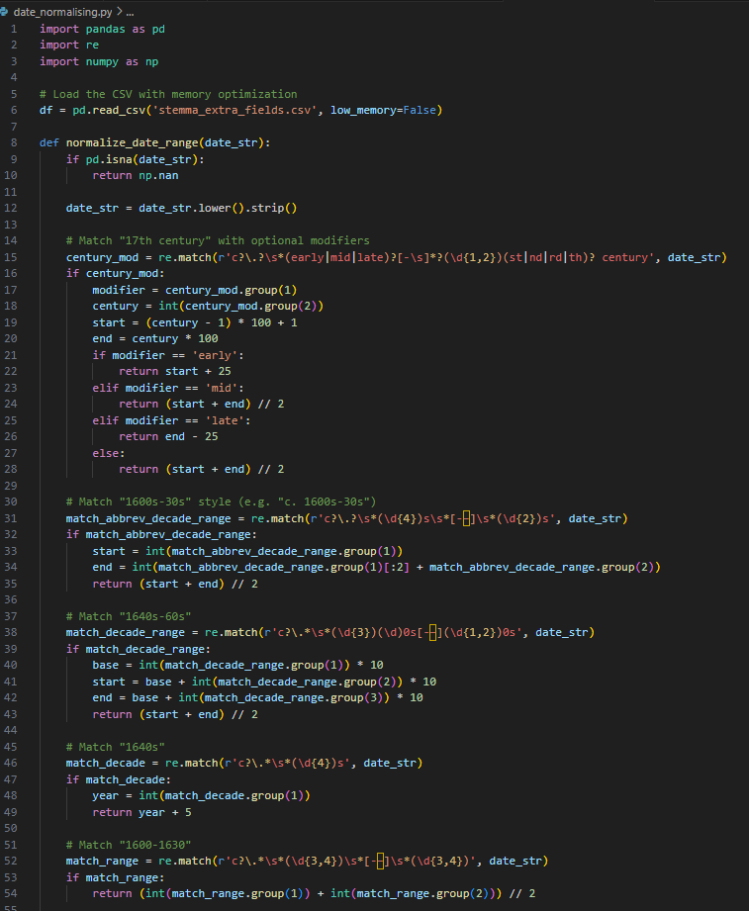
The Breakthrough: CELM Numbers and Normalising Data
Used as stable, work-level identifiers
Available consistently across metadata
Enabled grouping and analysis of witnesses
Weighted each indicator equally

Slide 13
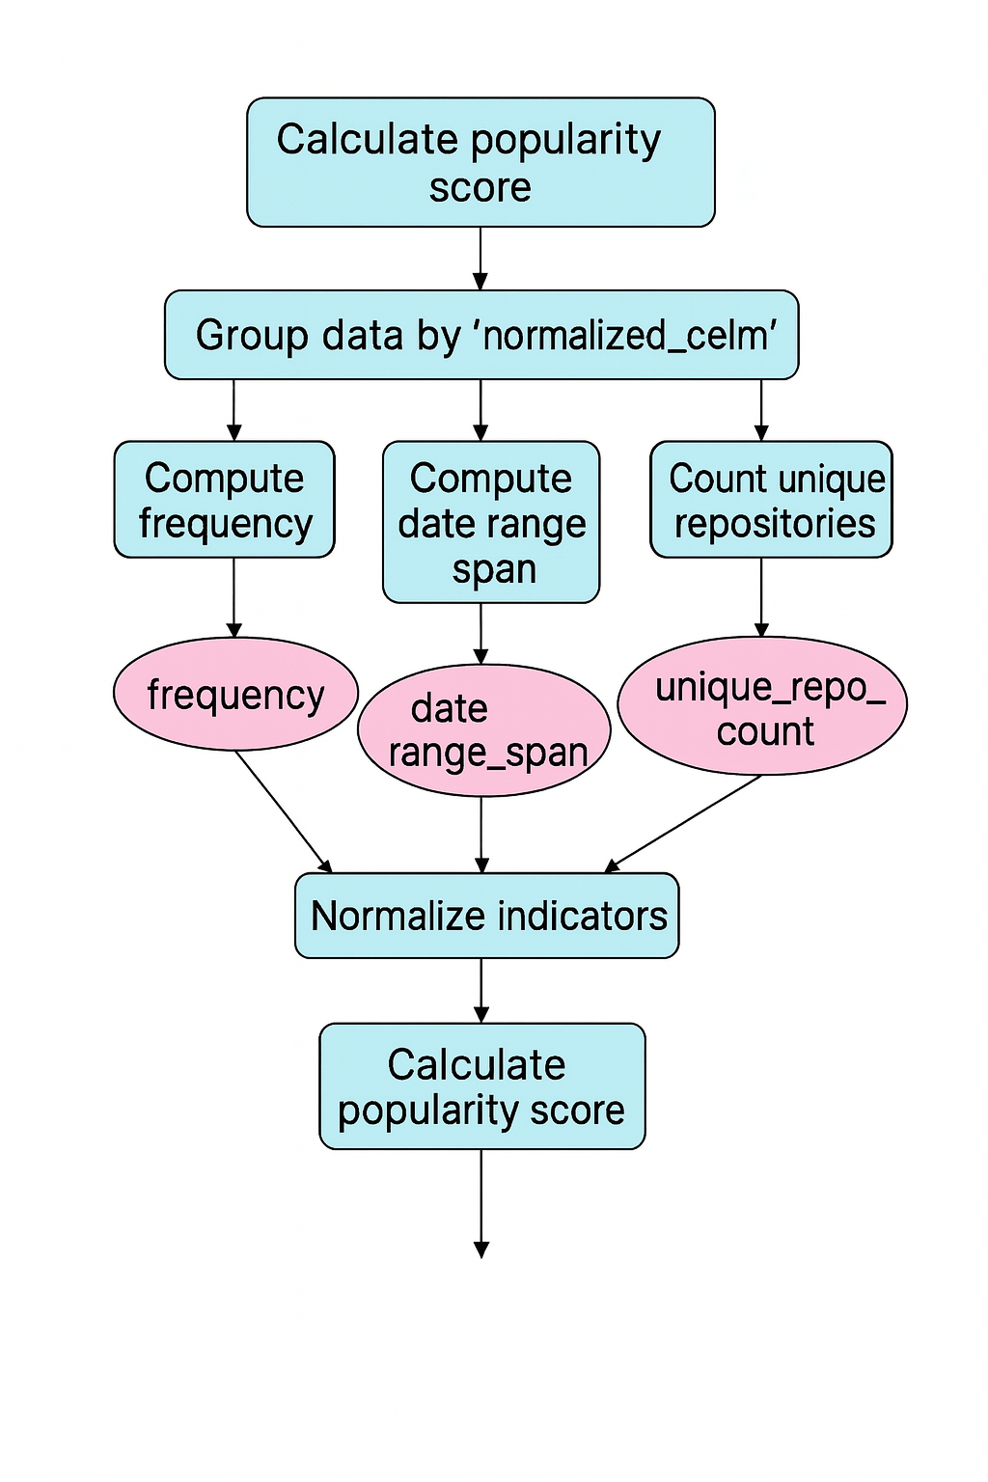
Popularity Score Algorithm (Flowchart)

Slide 14
The Popularity Score Formula
Popularity Score = 0.5 * NormFreq + 0.3 * NormRepo + 0.2 * NormSpan
• NormFreq: Normalized frequency of a poem's appearance across all manuscripts.
• NormSpan: Normalized span in years between the earliest and latest witness of the poem.
• NormRepo: Normalized count of distinct repositories preserving the poem.
Each value is scaled between 0 and 1 using Min-Max normalization.

Slide 15
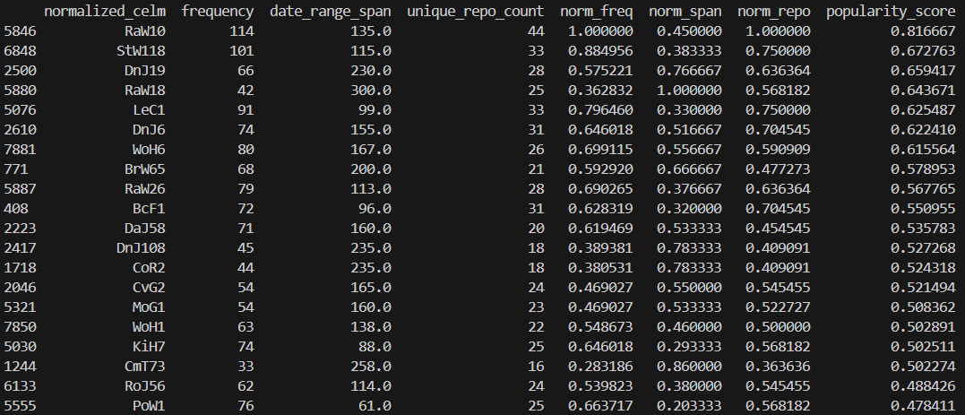
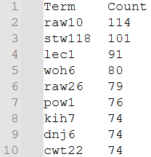
Demonstration & Results
Processed dataset of poetic witnesses by CELM number
Ranked by frequency, date range, and repository spread
RaW10: 114 occurrences, 44 repositories, 100+ years
Weight Adjustments
Just Frequency

Slide 16
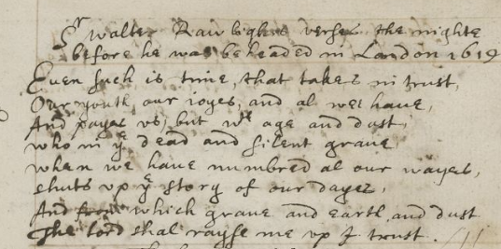
Top Hits

Slide 17
Reflections & Dissemination
Early ideas led to stronger metadata-driven model
Possible next steps:
– Compare with literary critical reception
– Adjust weights to model different kinds of popularity
– Study correlation with poetic style or quality

Slide 19
(Longer Deck – notes toward the presentation deck, minus GUI and Top Hits)

Slide 20
Turns out, there is more than one type of STEMMA user ….
Team 1: Andrew Finnerty, Greg Kneidel, Ray Siemens, Xinyi Zhang

Slide 21
Approach: Empathise
Our journey began with an empathetic response to hearing from those we interviewed that they wanted to be able to do more than the current STEMMA data set allowed.
Those we interviewed fell largely into two definable groups:
those that wished to use STEMMA data to locate poetry to read, study, or teach, and
those that wished to use it as part of expert research processes

Slide 22
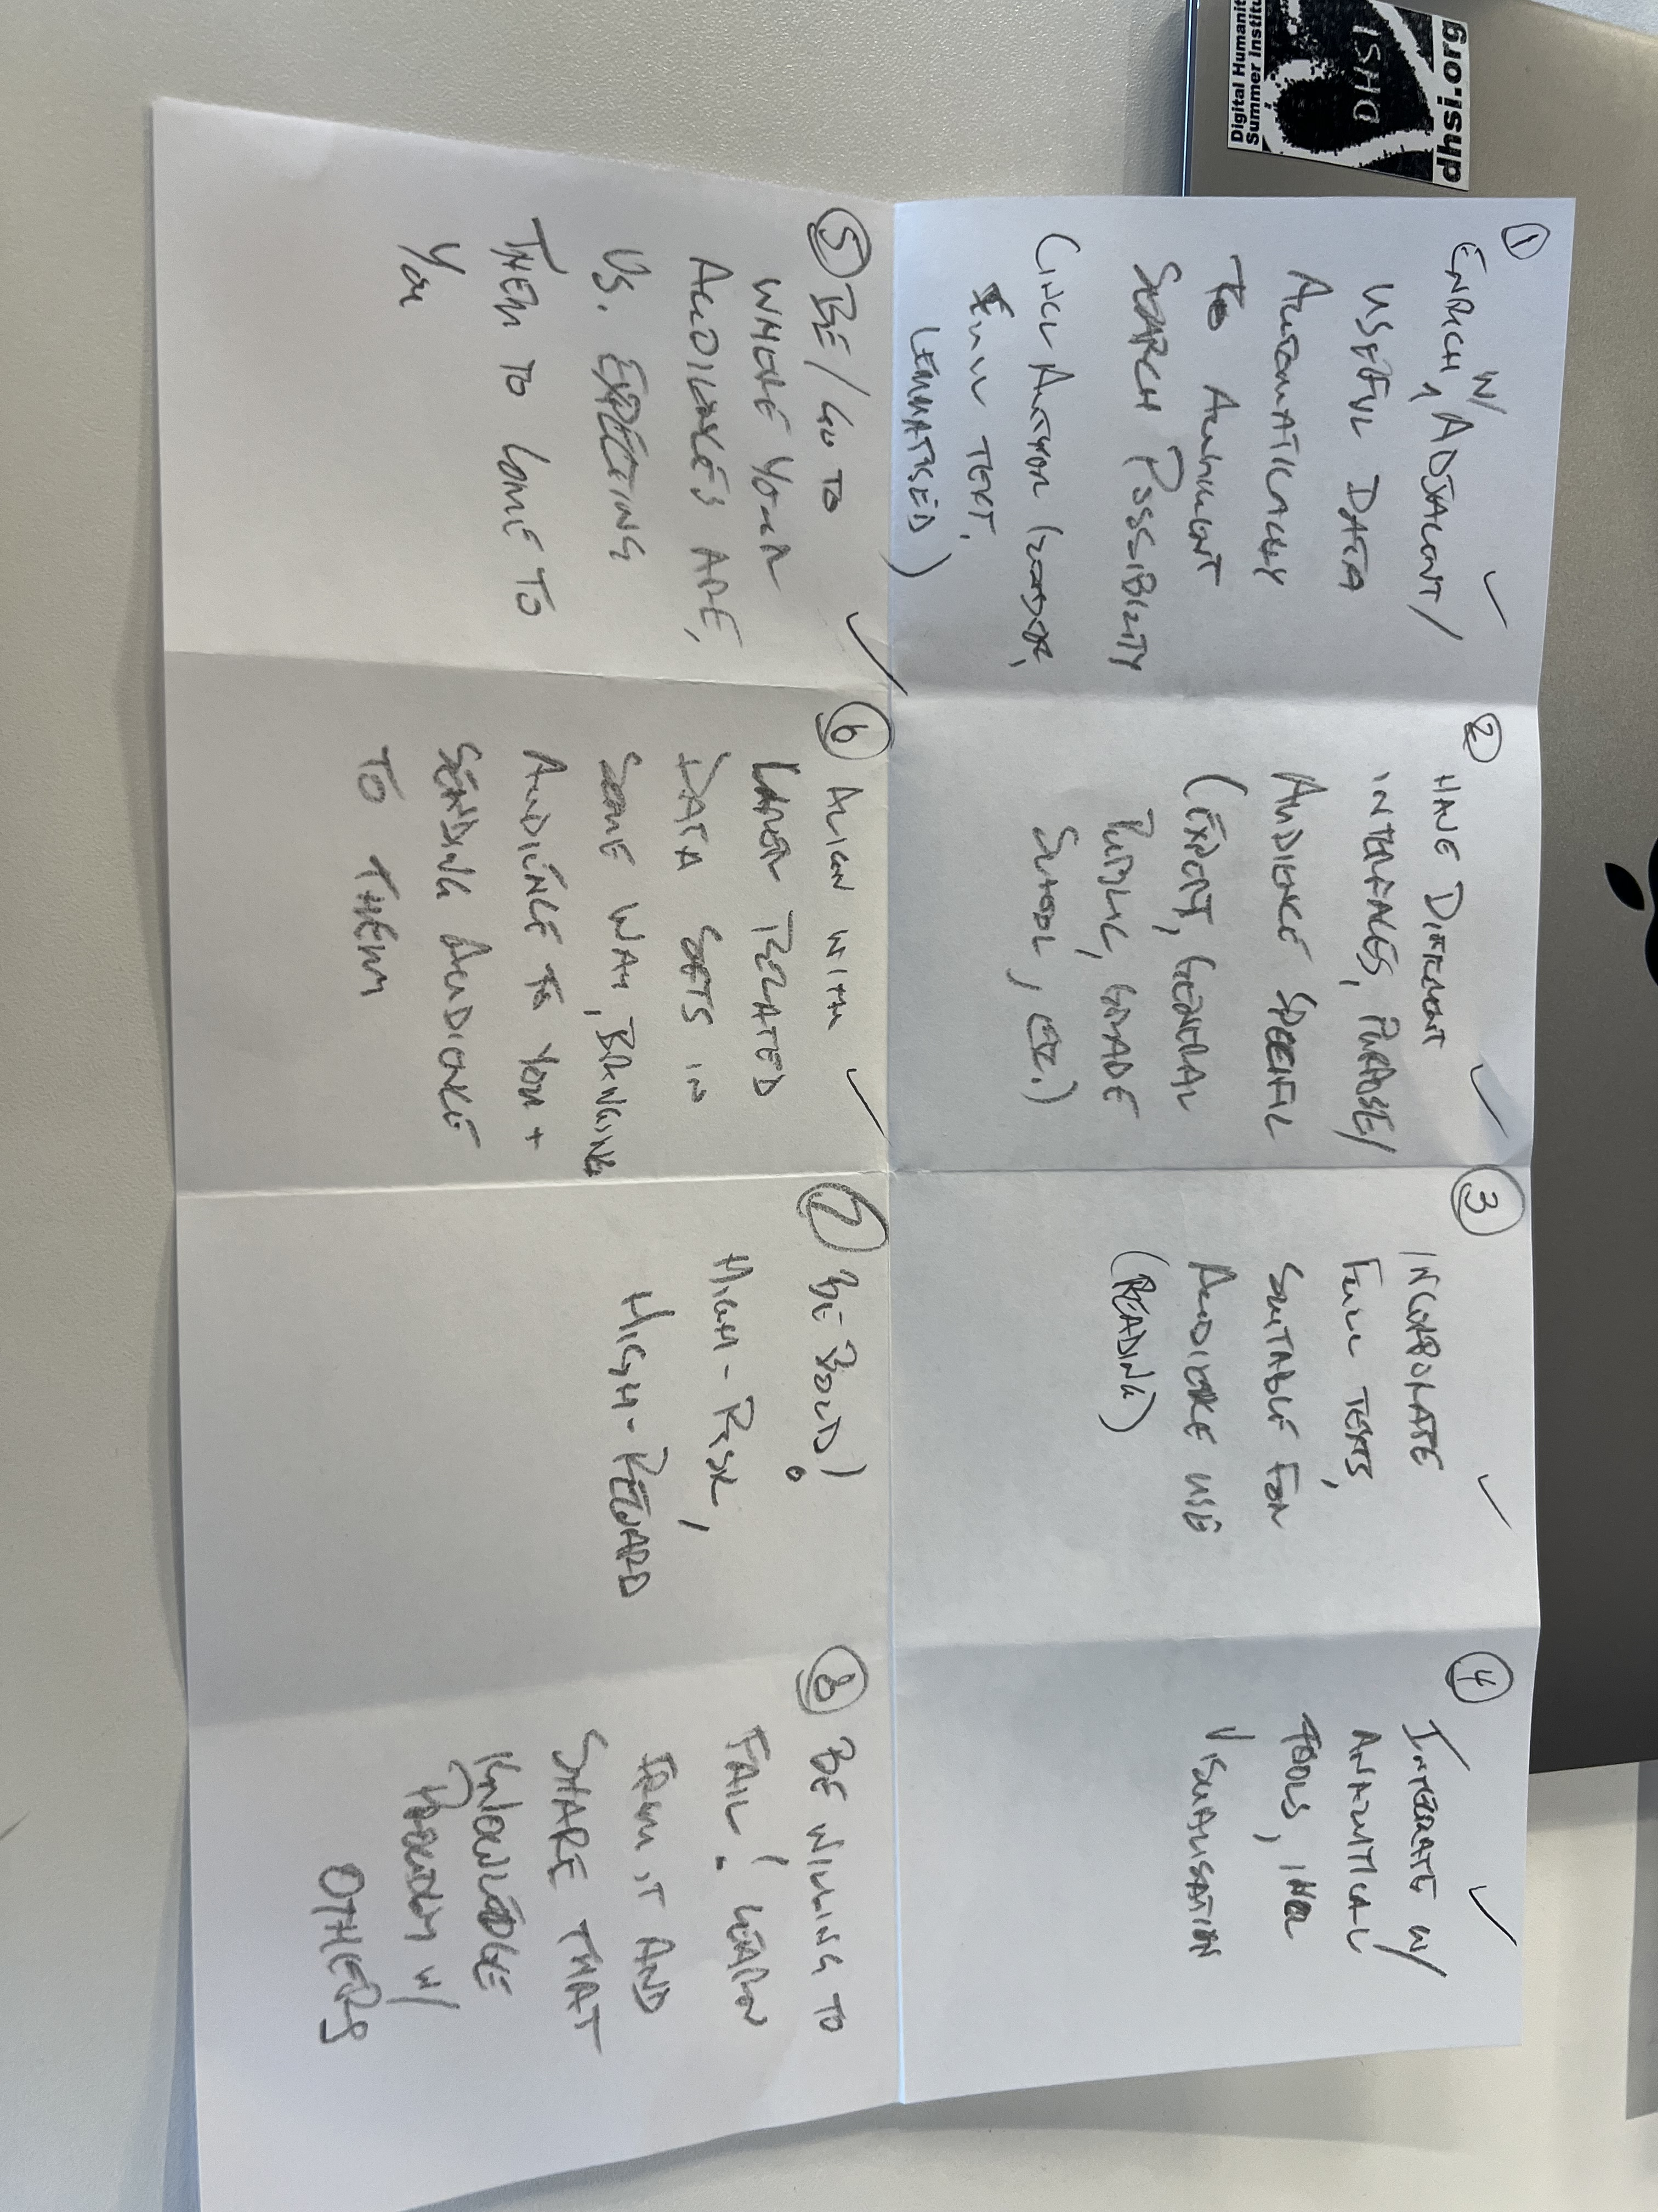
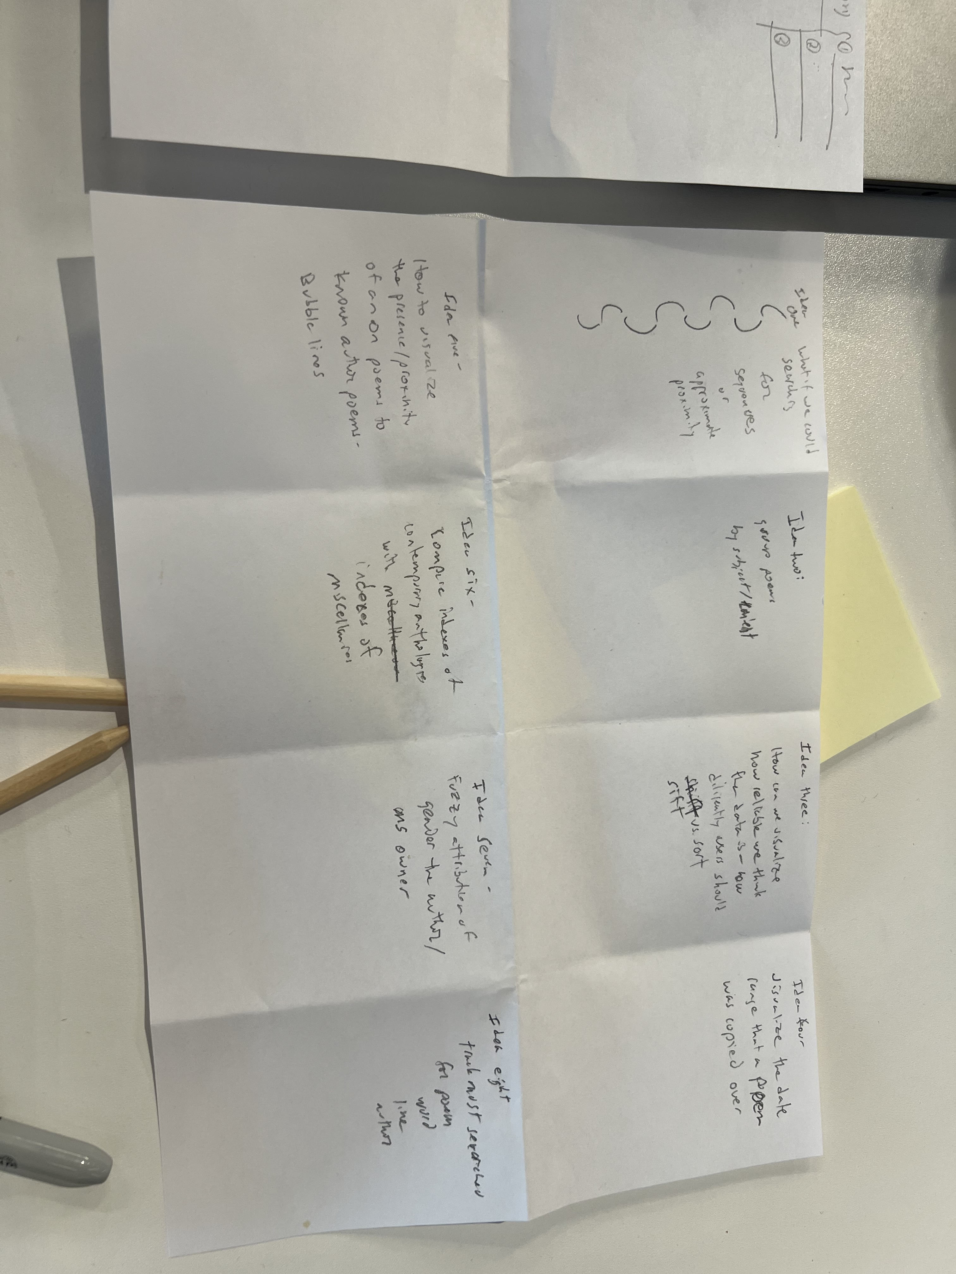
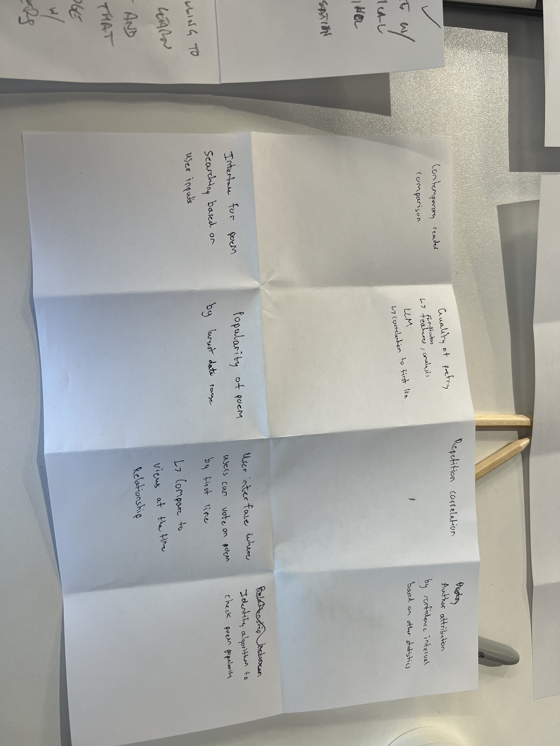
Approach: Design
The key points of our initial design followed, chiefly on how to support a more robust, potentially divergent, research experience with STEMMA

Slide 23
Approach: Ideate [1]
Ideation focused on a divergent user interface reflecting
augmented underlying data,
useful functions (to expert and non-expert audiences)

Slide 24

Approach: Ideate [2]
Data: Others have commented on the challenges of munging the data sets that comprise STEMMA, and we urge that more data be drawn in yet – likely functionally aligned with (rather than fully incorporated within) existing data.
We imagine this to be significantly automated, and recognize that this may introduce some possibility of error at the same time as it will increase potential utility – meaning that those using this for expert purposes will need to double check (a best practice regardless).

Slide 25
Approach: Ideate [3]
Data enriched in this way could help complete missing areas in the current data set – things like
fuller descriptions of manuscripts,
their provenance,
their histories etc (drawn from integrating with existing resources that do this)
the presumed gender of authors (drawn from named lists);
the full text of poems (drawn from aligned resources) and
keyword content / type / genre representation (automatically generated).

Slide 26
What We Found: Prototype [1]
As we entered initial prototyping, following input from two mentors, we consider ways to support the experience of each type of user group …
So our research problem became largely a research-on-research problem, asking how to address articulated needs of both these types of users, and focusing in part both on underlying data and on interface, and engagement.

Slide 27
What We Found: Prototype [2]
Interface: The interface would feature a simple splash page encouraging a question be asked or search term input.
An input that might appear less research oriented – “Show me poems written by women that comment on love relationships”
moves one to a results screen that would answer just that, but not provide further options (save for a button to move to ‘advanced mode’) and offer prompts to similar things that others have requested.
An input that would appear oriented more toward expert research – “What are all witnesses to [poem x] in chronological order, with full text?”
moves the user to a screen with more detailed search possibilities, including those that match the data fields of the STEMMA data set.

Slide 28
What We Found: Prototype [3]
Expert interface functions:
Gateway to useful data-related functions – some ‘scholarly primitives’ others more advanced
We’ve discussed these with others in our group, happy for alignment and collaboration
We’ve modeled one more fully, around how to find the top hits in the STEMMA dataset (with apologies to the Riddle of Literary Quality project)

Slide 29
What We Found: Test [1]
Testing also introduced the issue of engagement. We were encouraged by our mentors to imagine outward-facing engagement for audiences we could readily identify.
So far, we’ve imagined expert audiences being engaged by scholarly articles and presentations, with STEMMA citations, as well as cross-linking to the sites of scholarly associations and key journals and online resources in the area – perhaps a space, too, for ‘teaching with STEMMA’.

Slide 30
What We Found: Test [2]
For non-scholarly audiences, we imagined some playful social teasers, like a game that presents Donne-authored complaint or lament, asking if it sounds like Taylor Swift ….

Slide 31
The thought experiment got us this far, but we took it a few steps further …

Slide 32
More tangible results [1] GUI MockUp

Slide 33
More tangible results [2] Hot Tips on the Top Hits

